Slide 1
FitnessProgressTracker
Curs Work
Team: Ninja Turtles

Slide 2
Itroducing the team members
Yousef Barakat (github: Mcgarrett)
Mariyan Baltov (github: mariyanb007)
Kristina Cvetkova
Nikolet Dimitrova
Hristo Kovachev (github: icokovachev)

Slide 3
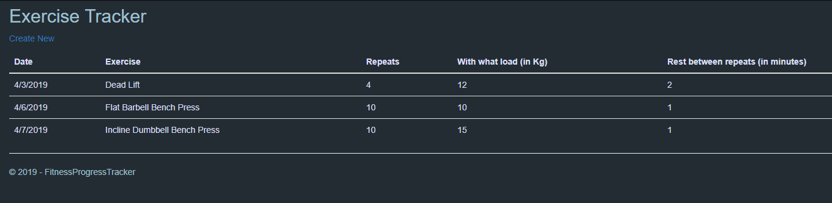
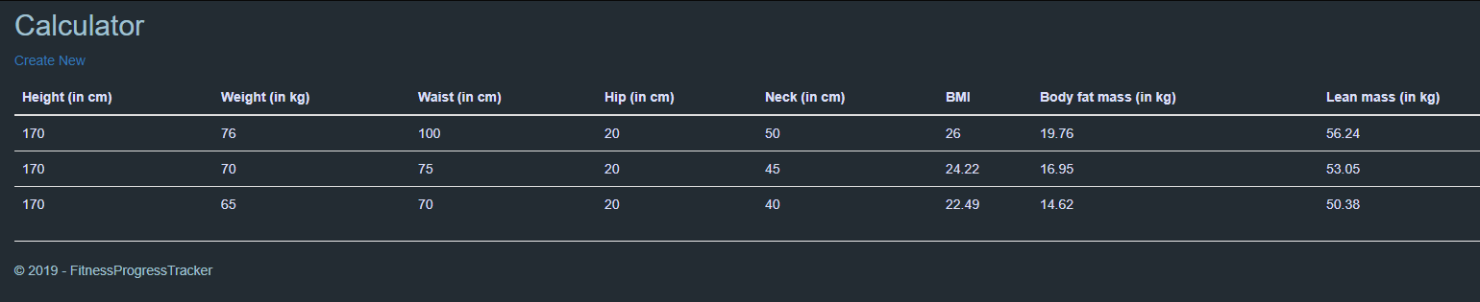
The idea behind the project
Tracking your daily activity in the Gym
Tracking your body indicators

Slide 4

About the technology we used
The platform is writen in C# (controllers and main functions), HTML&CSS + JavaScript (view), Entity Framework + SQL Server (DB);
We used the MVC template for the creation of the web app;

Slide 5
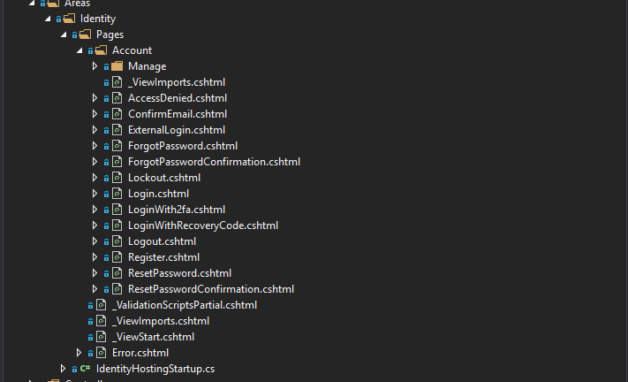
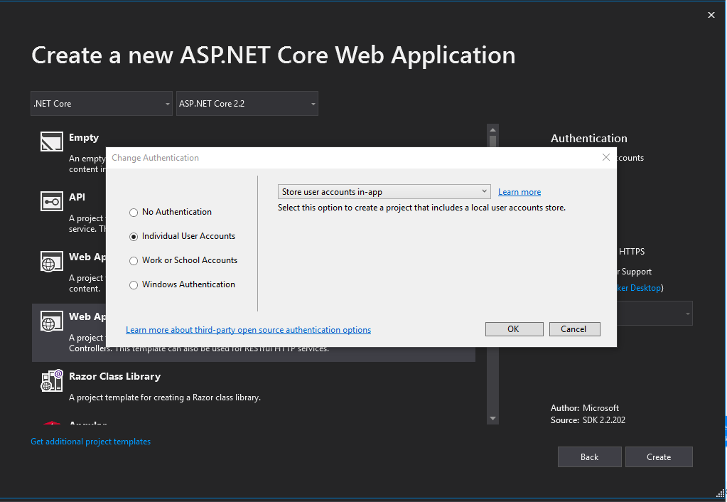
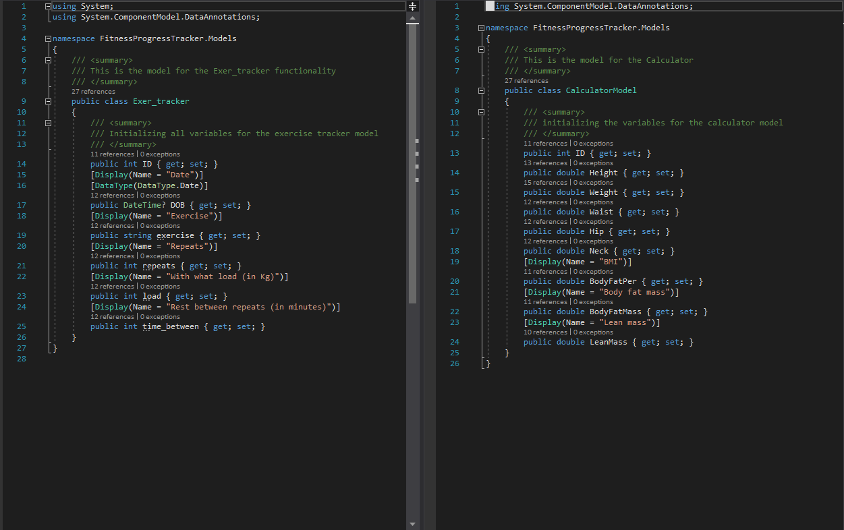
We chose to use the ready authentication;
We created 2 Models and used scaffolding for the Controllers, Views and DB;

Slide 6
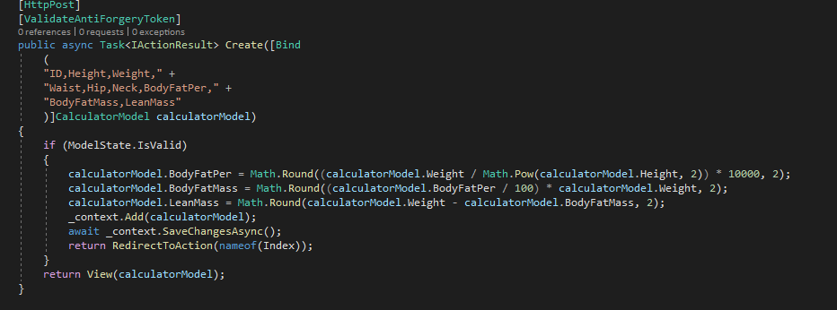
Calculator
This functionality takes 5 variables and executes 3 formulas :
For the BMI
The Body fat mass
The Body lean mass

Slide 7
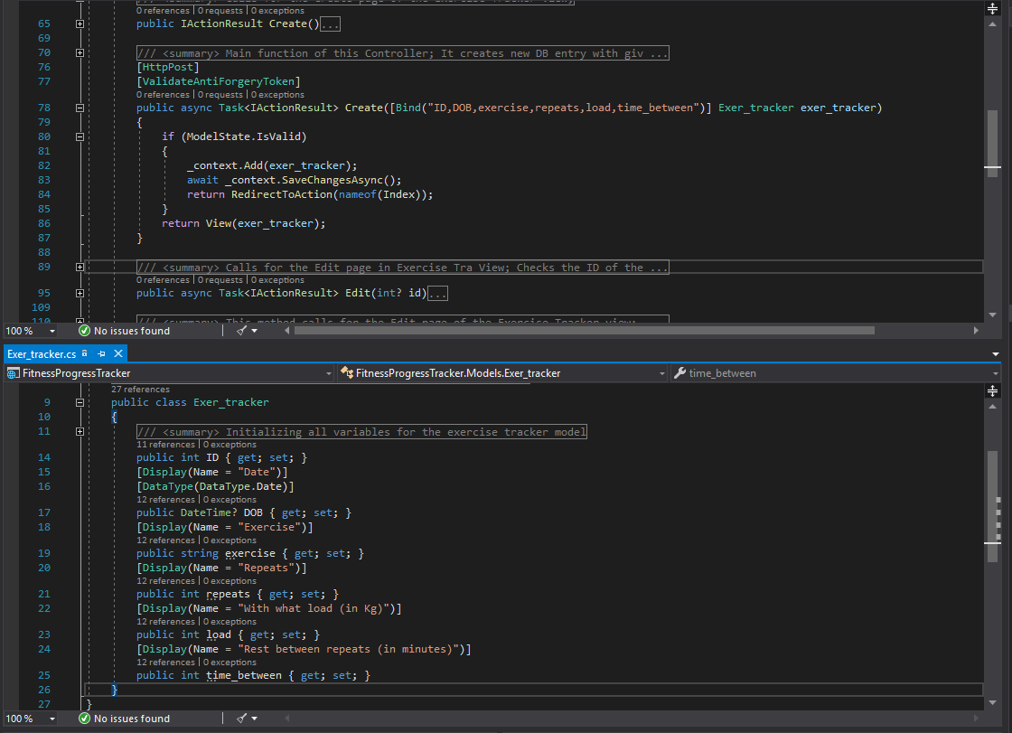
Exercise Tracker
The exercise tracker takes the date, type of the exercise and some more variables and place them in DB

Slide 8
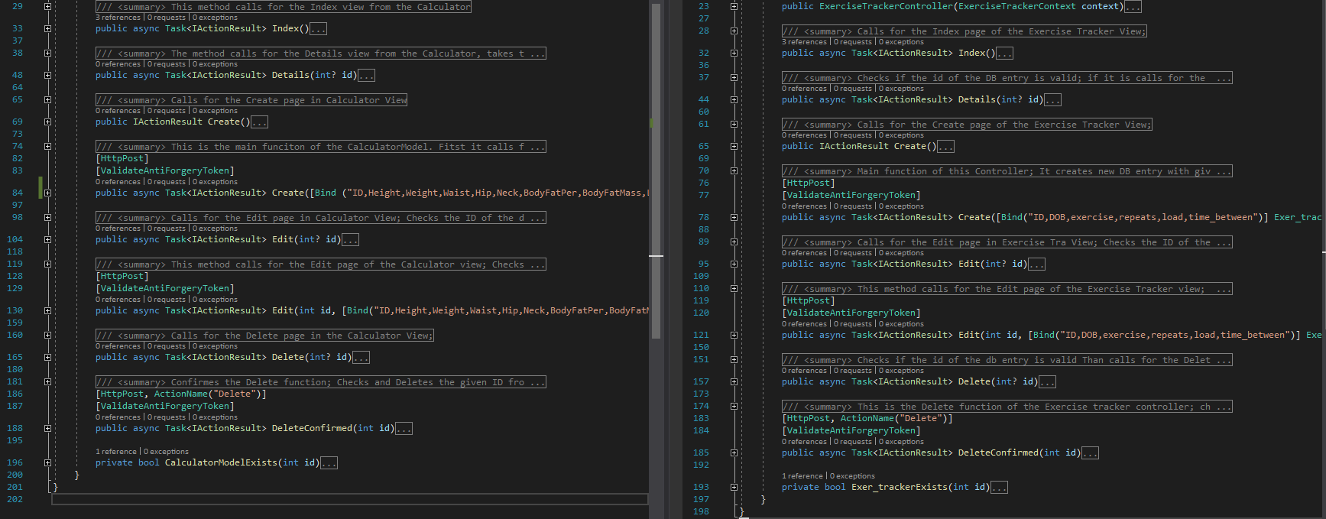
Using CRUD
Both of our models uses CRUD for the DB; That allows the user to change the values if he/she/”it” made a mistake (like the one with the gender situation)

Slide 9
Plan for the future of the project
Unit testing /Lack of time; late start (oops…this was our bad)/;
Adding some new functionalities to the project;
Improving of the existing functionalities;
Making all private for the user /again…lack of time/

Slide 10
To make it easy for the people to track their activities in the Gym.
And pass the God damn exam…

Slide 11
Thank you for the attention!
Sorry if there are some misspellings. And if I stammered…
Team: Ninja turtles

